Slide 1
Advance Modelling for Operations
Group 1

Slide 2
5. Class Train:
1. __init__
The position of the tuggers at the beginning of the simulation cannot be equal…tuggers cannot lay on each other. Could influence the consumption the day after, for instance. That is why it should be considered, for both modelling purposes and reality issues.
Next stop→ If we take into account acceleration and deceleration, if no loads in the next stop have to be charged there is no point in stopping there (saving time, energy, etc.). Thus it is not mandatory to stop at line 1 everytime
2. check_charge: “NA” [Domanda: Non ha senso che la selezioni randomly…]
3. move
“if self.model.schedule_lines.agents[self.next_line].UL_in_buffer >= 1” is wrong. It does not take into consideration the possibility of the lines to create a new UL.
Self.load < self.capacity -> It does not take into consideration the loading’s limit of the tugger. ULs weights differ!
self.remaining_energy -= compute_energy(loading_time) -> Energy consumption depends on the activity (loading in this case) and not solely on time.
self.load += 1 -> Why can’t the tugger take on more ULs than one if it has space?
4.charging:
Do batteries charge linearly? No, charging time depends on battery load.
5.step:
Modelsystem is in integers whereas tasktime is in floats…we are loosing time.
6. ChargingStation:
a) Need to convert the steps in a smaller time unit to avoid loss
6. General: MOVEMENT IS INSTANTANEOUS? CAN WE ACHIEVE A CONTINUOUS MOVEMENT ON THE GRID?
Additional Comments:
Change time-formatting (in minutes)
Between station 3 and 4, the tugger “steals” 10 meters (it gets back, rather than going forward to 75): SOLVED
The tugger does not move, it says fixed at the 1st station, i.e., station[0].: SOLVED
Weaknesses
Errori di modello:
Errori di implementazione:
01
Average speed meant to account for high-speed travel, low-speed turns, and acceleration/ deceleration times.
02
Constant speed
Battery size
Battery size decreases throughout time depending on the usage.
03
Random.uniform(0,1) is added independently of the distance travelled while it depends on the path the tugger has to do.
04
Energy does not depend solely on time but also on other variables such as loading weight or speed (acceleration, deceleration)
Compute time
Compute energy
05
Random.uniform(0,1) is added independently of the distance travelled while it depends on the path the tugger has to do.
06
Energy does not depend solely on time but also on other variables such as loading weight or speed (acceleration, deceleration)
Class train
Code refactoring

Slide 3
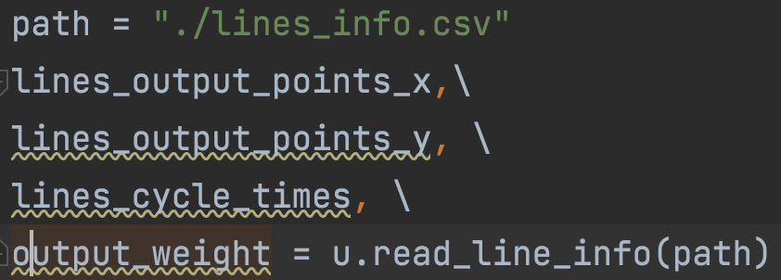
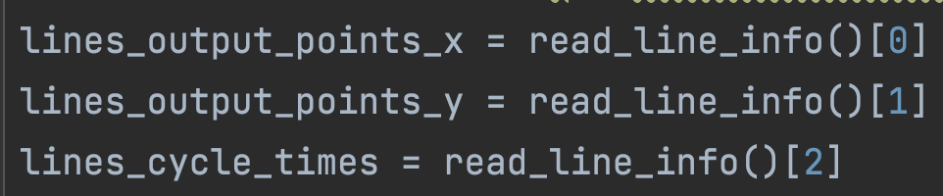
Refactoring read_line_info
In the basic case, the function read_line_info was called three times when in practice we can use Python unpacking feature to call the function just once. Moreover, we decided to give the project a clearer structure, by dividing the entire code in two distinct files: the first one called main, wich contains the model implementation, and the second one called utils, in which we included all the functions to compute energy consumption, speed, distances, time and so on and so forth. For the description of the function we included into the utils module, you can refers to the original python script. In general, we included all the function not related to the MESA package method in the utils module to build a more flexible code.
Adding weight capacity constrain
In the basic case code, the weight capacity wasn’t modeled. We decided to add the weight of each unit load in the file of line coordinates and return all the weights in a list called output_weight. Tugger train now will check if it has enough spare weight capacity to load the next line UL and if it hasn’t, it will go on to the next line or eventually to the warehouse to unload the units.

